Slide 1

Text Summarization of COVID 19 articles using Question and Answering System using BERT & GPT-2 Review-4 9-Apr-2023
Venkat K Pillai

Slide 2
AGENDA
Problem Statement
Abstract & Scope
Literature Survey
​Suggestions from Review
Design Approach
Design Constraints, Assumptions and Dependencies
Proposed Methodology and Approach
Architecture
Design Description
Tech Ecosystem
​Summary​
References

Slide 3
Problem Statement
Since the outbreak of COVID 19 , there has been attempt to study and publish articles related to COVID-19 that are publicly available, to the medical community and wider society. However the challenge of browsing through every article to look for specific content is time consuming and time intensive.

Slide 4
Abstract and scope
The system aims to tackle the recent challenge of mining the numerous scientific articles being published on COVID-19 , available in CORD-19 Dataset in Kaggle , by using a question answering mechanism and summarize the article with highest probability to the related information.
It combines the use of State of Art Haystack Opensource Framework to identify and extract specific snippets related to user query and summarize the article source using BERT and GPT-2 models.

Slide 5
Literature Survey
R Vaishya and Kricka have noted that the emerging technologies are set to play an important role in worlds response to the COVID-19 pandemic and similar situations.
Broth Andreas et al. proposed a Question- Answering (Q/A) system over Knowledge Bases(KB), which overwhelms impediments which were endured—namely, porting KBs language-agonistic systems.
Rajpurkar, Pranav and team presented the Stanford Question Answering Dataset (SQuAD),
.
Esteva implemented a retriever-ranker semantic search engine devised to handle complex queries regarding COVID-19
Qiao Jin, Bhuwan Dhingra introduced PubMedQA, a novel biomedical question answering (QA)
Nogueira Rodrigo re-implemented the query based passage re-ranking. Trained on state of the art TRECCAR dataset
In Abacha tried to solve one of the challenges in large-scale information retrieval (IR) is developing fine-grained and domain-specific methods to answer natural language questions

Slide 6
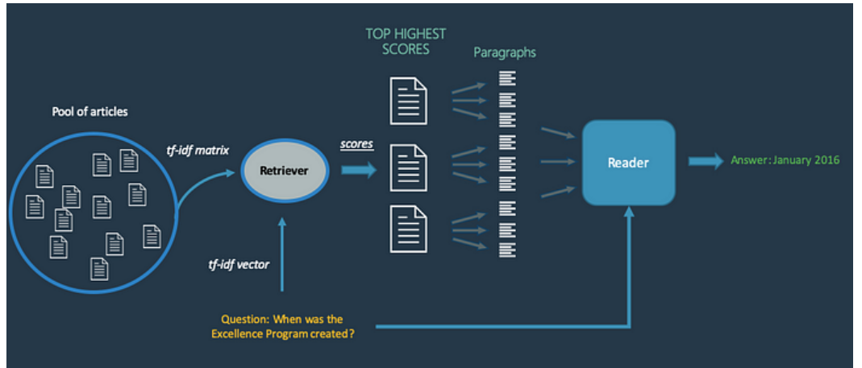
Proposed Methodology and Approach
cdQA - Closed domain question answering (CDQA) is a broad name for the task of answering questions only from one domain, for example legal, medical, engineering, etc. The cdQA architecture is based on two main components: the Retriever and the Reader. You can see below a schema of the system mechanism.
Source : https://morioh.com/p/1b428c616eb9

Slide 7
Readers Used
Roberta-base-SQIAD2
Roberta-base-SQUAD2-COVID
deepset/covid-bert-base
This is the roberta-base model, fine-tuned using the SQuAD2.0 dataset. It's been trained on question-answer pairs, including unanswerable questions, for the task of Question Answering.
This is the roberta-base model, fine-tuned using the SQuAD2.0 dataset specifically designed for COVID. Question Answering.
Overview
Language model: roberta-base Language: English Downstream-task: Extractive QA Training data: SQuAD 2.0 Eval data: SQuAD 2.0
Language model: deepset/roberta-base-squad2 Language: English Downstream-task: Extractive QA Training data: SQuAD-style CORD-19
Source : https://huggingface.co/deepset

Slide 8
Proposed Methodology and Approach
BERT (Bidirectional Encoder Representations from Transformers) is a state-of-the-art used in wide variety of NLP tasks, including Question Answering (SQuAD v1.1),. BERT makes use of Transformer, an attention mechanism that learns contextual relations between words (or sub-words) in a text
GPT-2 GPT-2, or Generative Pre-trained Transformer 2, is a powerful language model developed by OpenAI that is capable of generating high-quality natural language text. While GPT-2 was originally designed for tasks such as language translation and conversation generation, it has also been used for text summarization. GPT-2 summaries can be highly accurate and useful for a variety of applications, including news and article summarization.

Slide 9
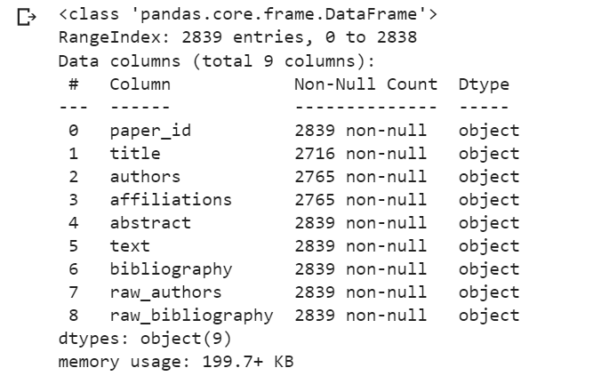
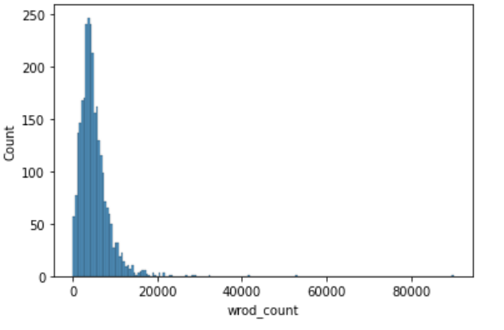
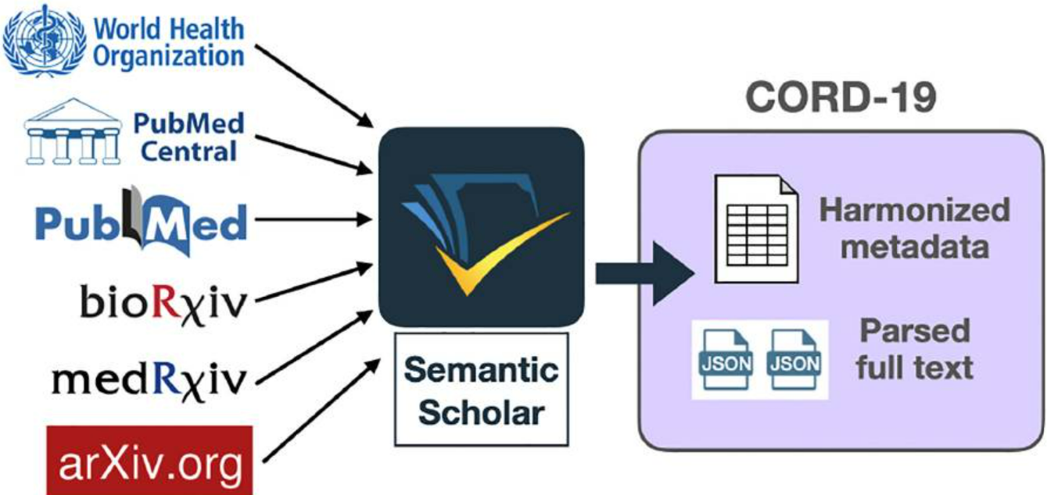
CORD19 Dataset
Data Structure
Word Count Distribution

Slide 10
Proposed Methodology and Approach
NLP
Json file ingestion from Kaggle CORD 19 dataset
Data clean-up and pre-processing
Convert to DataFrame
Convert DataFrame to documents for Haystack indexing pipeline
Extract top 5 response from retriever-reader pipeline and Identify source document of response
Summarize text using BERT and GPT-2

Slide 11
Architecture
NLP
CORD-19 Dataset
json file Extraction
Pre-processing
Feature Extraction
Documents
Haystack Open Framework
Retriever
File Convertor
Document Store
Reader
Pre-processor
Answer
Indexing Pipeline
Search Pipeline
Document Summarization
Results
BERT
Generated Response
GPT-2
ROUGE Scores

Slide 12
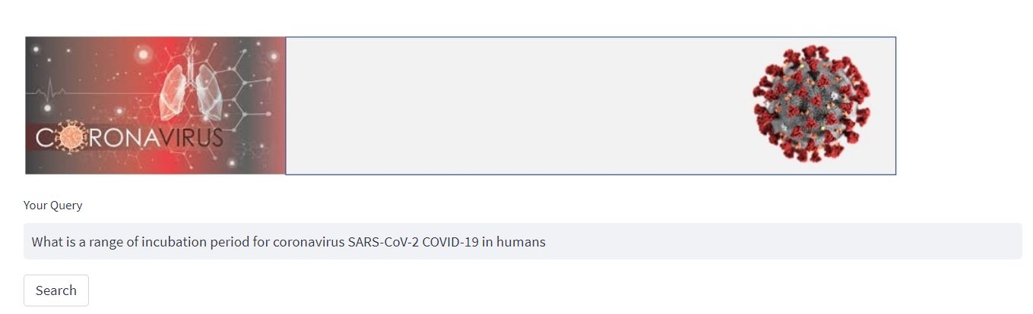

Proposed System
1. Streamlit front end for Q&A
Version: 1.76.2 (user setup)Commit: ee2b180d582a7f601fa6ecfdad8d9fd269ab1884
Date: 2023-03-14T17:55:54.936Z
Electron: 19.1.11
Chromium: 102.0.5005.196
Node.js: 16.14.2
V8: 10.2.154.26-electron.0
OS: Windows_NT x64 10.0.22621
Sandboxed: No

Slide 13
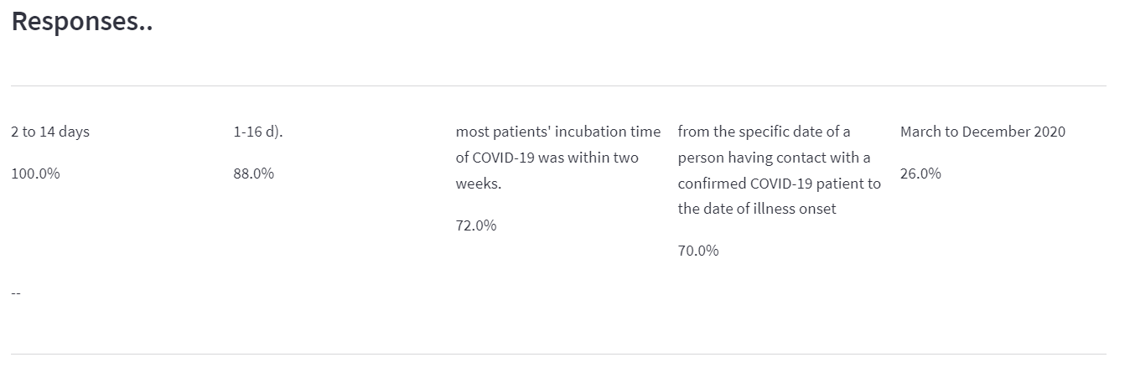
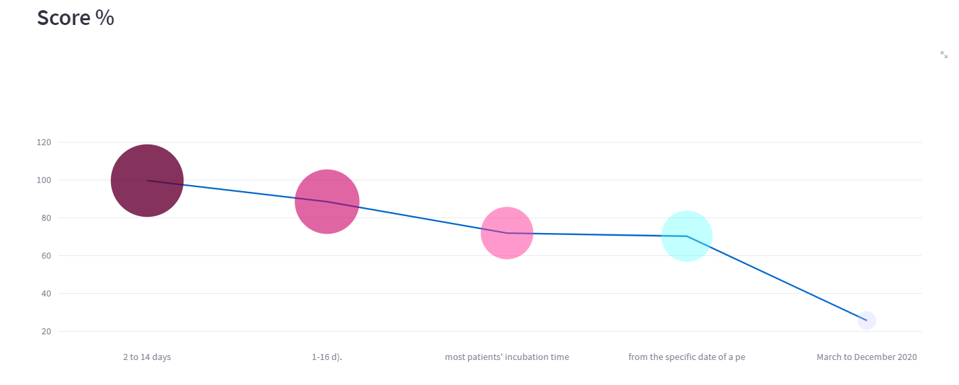
Proposed System
2. Top 5 responses based on Reader-Retriever outcome.
Default Reader - deepset/roberta-base-squad2-covid' (Roberta model)
DocumentStore – InMemoryDocumentStore
Retriever - BM25Retriever

Slide 14

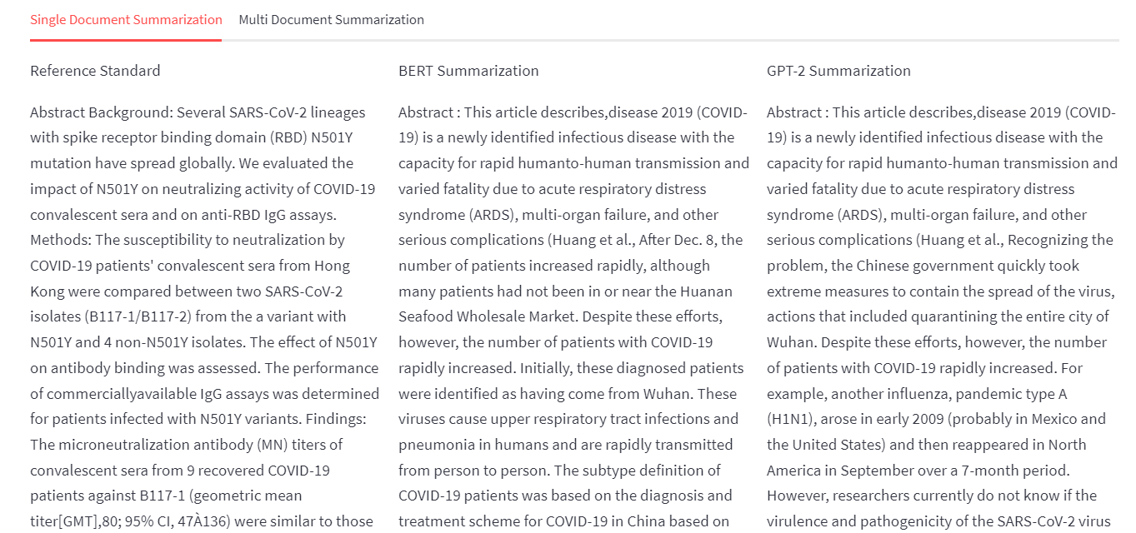
Proposed System
Choose and summarise article ( Default highest scorer picked)
Summarization based on BERT and GPT-2

Slide 15
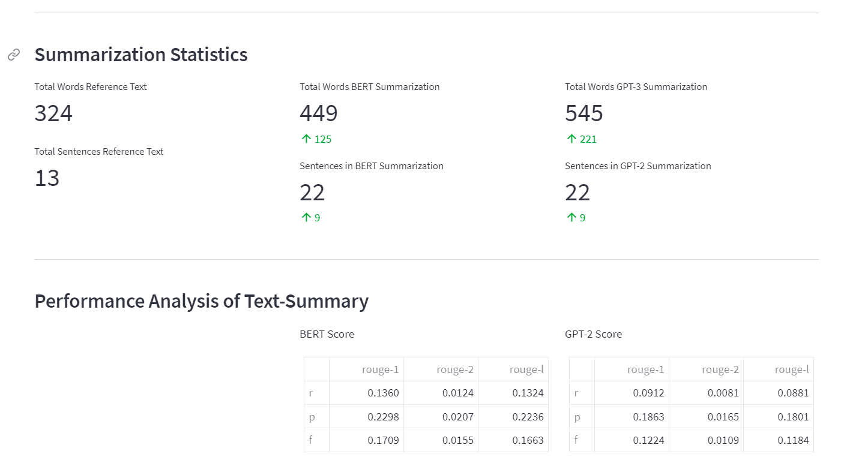
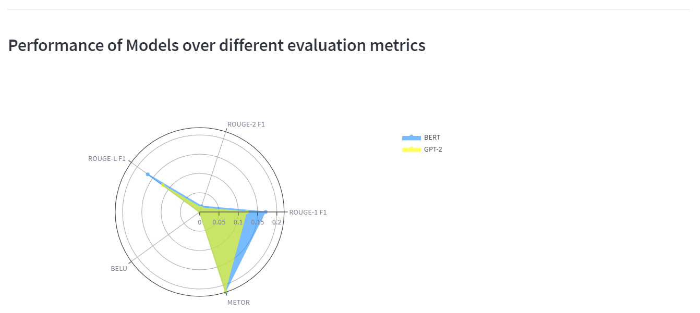
Proposed System
4. Performance Analysis

Slide 16
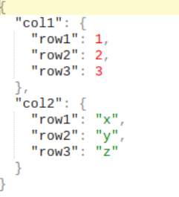
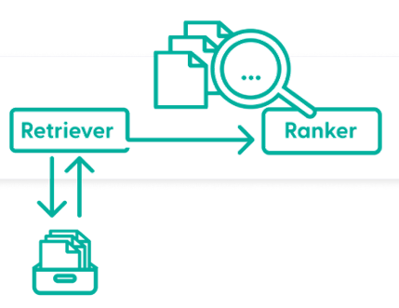
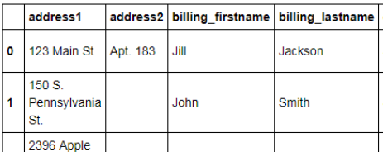
Design Approach
Input Text
Token Embedding
Question
Interval Segment Embedding
Position Embedding
BERT
GPT-2
Summarization Layers
Generated Summary

Slide 17
Design Constraints, Assumptions and Dependencies
1. Proper and complete question text performs better than short texts
2. Both the readers are tuned for English language only
3. Deprecation of some of functions in Haystack platform.

Slide 18
Reader -Performance Analysis
What is the optimal quarantine period for coronavirus COVID-19”?
 | Roberta-base-SQIAD2 | Roberta-base-SQUAD2-COVID | deepset/covid-bert-base
Response1 | Feb 24 until | Quarantine longer than 30 days | Climatically temperate regions …
Response2 | 29.45 Days | quarantine length longer than 30 days | raisons and soft tissue injuries
Response3 | 14-day | 14-day | 88
Response4 | 30 days | Restrictions of asymptomatic healthy people… | respiratory capacity , primarily in patients with chronic
Response5 | nation wide quarantine | Average qurantine days was 29.45 days with standard deviation of 7.34 days | Mandatory variable …

Slide 19
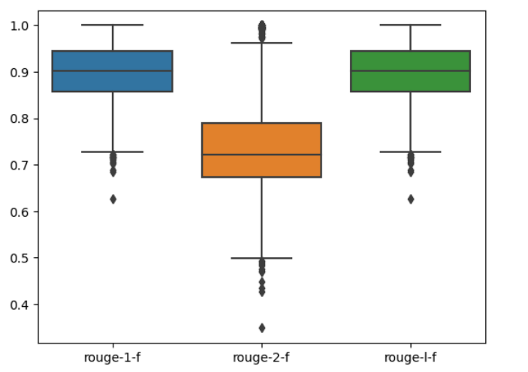
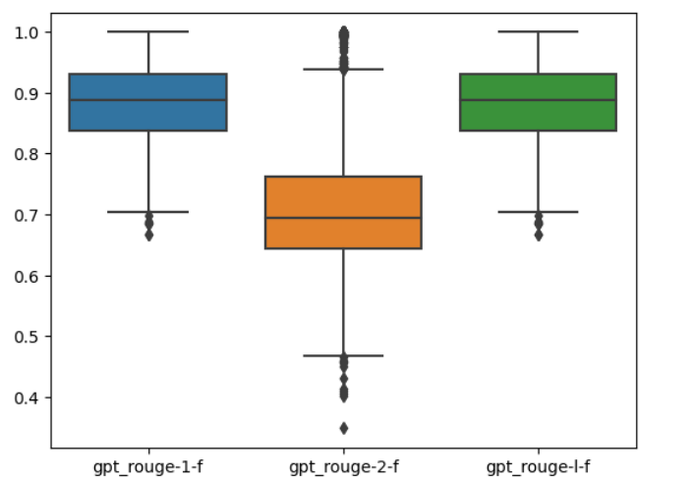
Text Summarization Performance
F-Score | rouge-1 | rouge-2 | rouge-l
BERT | 0.896036 | 0.740987 | 0.896036
GPT-2 | 0.883358 | 0.716458 | 0.883358
BERT
GPT-2
Both BERT and GPT-2 show very similar results with Text Summarization, BERT had slight better performance
Outliers vary in both cases

Slide 20
Conclusion
Reader - Roberta-base-SQUAD2-COVID + Text Summarization – BERT Combination performed better for identification of right articles and summarizing them.
Further improvement fine tuning can be attempted.
Moving code to Streamlit Cloud

